Slide 1
Mobile Application Development - Day 13
CardView
RecyclerView

Slide 2
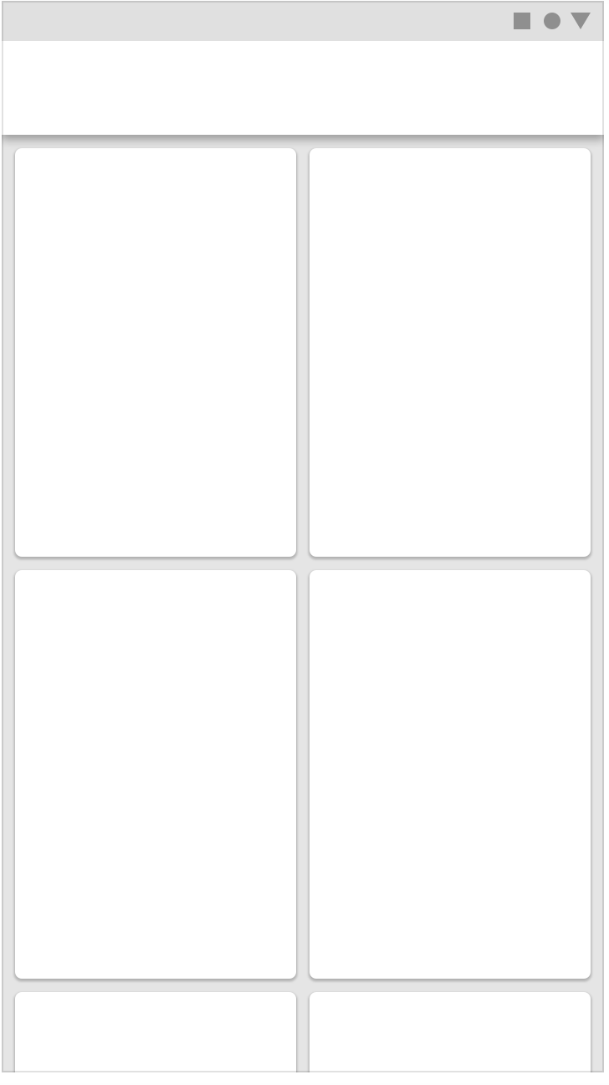
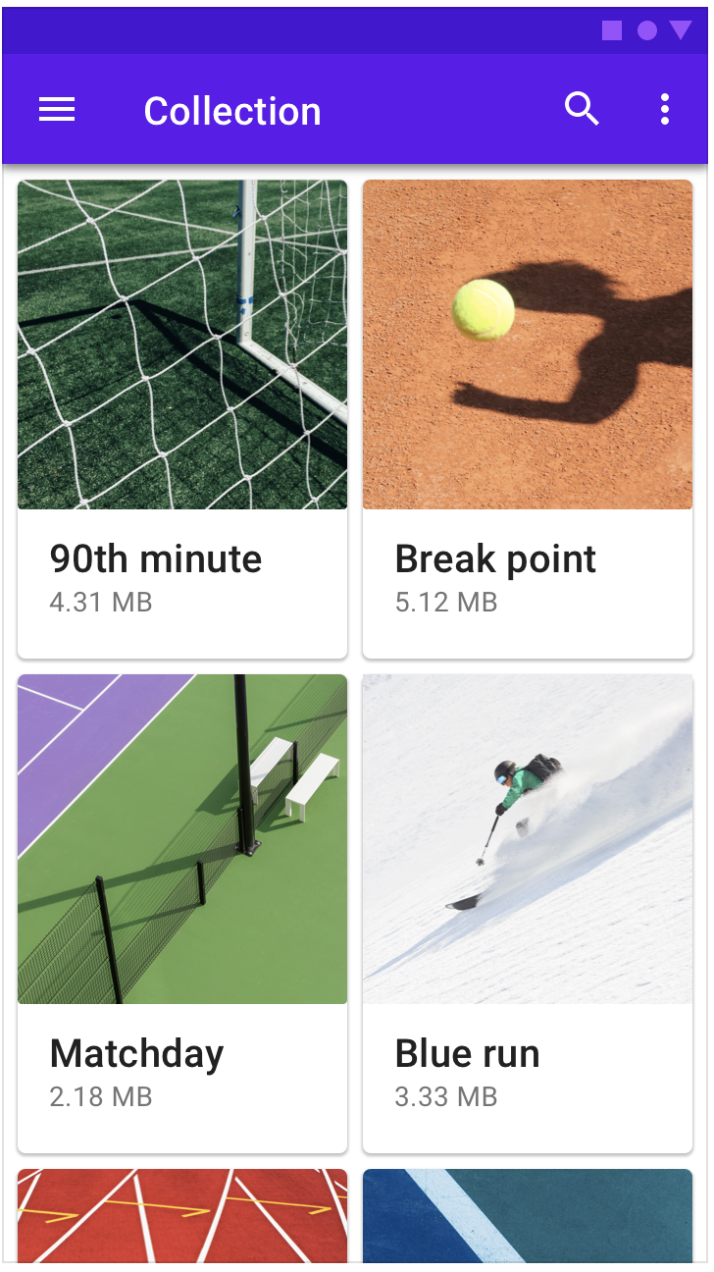
CardView

Slide 3
CardView
Use these properties to customize the appearance of the CardView widget:
To set the corner radius in your layouts, use the card_view:cardCornerRadius attribute.
To set the corner radius in your code, use the CardView.setRadius method.
To set the background color of a card, use the card_view:cardBackgroundColor attribute.

Slide 4
CardView
<android.support.v7.widget.CardView
xmlns:card_view="http://schemas.android.com/apk/res-auto"
android:id="@+id/card_view"
android:layout_gravity="center"
android:layout_width="200dp"
android:layout_height="200dp"
card_view:cardCornerRadius="4dp">
<TextView
android:id="@+id/info_text"
android:layout_width="match_parent"
android:layout_height="match_parent" />
</android.support.v7.widget.CardView>

Slide 5
CardView - Dependencies
dependencies {
implementation 'com.android.support:cardview-v7:28.0.0'
}

Slide 6
RecyclerView
a more advanced and flexible version of ListView
Layout managers
LinearLayoutManager
GridLayoutManager
StraggeredGridManager

Slide 7
RecyclerView - Dependencies
dependencies {
implementation 'com.android.support:recyclerview-v7:28.0.0'
}

Slide 8
RecyclerView
<android.support.v7.widget.RecyclerView
android:id="@+id/recycler_view"
android:scrollbars="vertical"
android:layout_width="match_parent"
android:layout_height="match_parent"/>

